Slide 1
Distance Measures
Part - 1

Slide 2
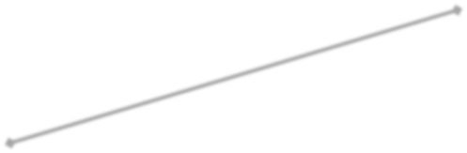
Introduction
Distance measures
Euclidean Distance-an example from school mathematics
To compute distance between two points
y
(x₂, y₂)
d
x₂ y₂
2 × 1
(x₁, y₁)
x₁ y₁
2 × 1
x

Slide 3
Introduction - Motivation
Why do we need distance measures?
To compare images - image matching
Object recognition
Face recognition
Content based image retrieval (CBIR)
Many other applications

Slide 4




Introduction - Motivation
Object Recognition
– An important aspect of visual perception
How does object recognition work?
Training Sample
Test Samples

Slide 5
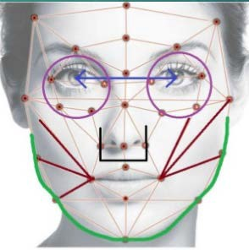




Introduction - Motivation
How do we do object recognition?
Object is represented using features
Feature is a scalar which quantitatively describes a property of an object
Feature vector: collection of features
Example of Facial Features
Distance between the eyes
Width of the nose
Length of Jaw line
Structure of the cheek bones
Depth of eye sockets
Compute the distance between these vectors to find similarity

Slide 6
K-Dim Feature Representation
Feature vectors of dimensionality k
representing two objects
x = {x₁,..,..x_{k}} and y = {y₁,..., y_{k}}
Representation of features of multiple Objects
Consider database of N objects
Each object represented using feature vector of dimensionality k
This is called Column-oriented representation
So all the objects can be collectively represented as a matrix
D of size k × N

Slide 7




K-Dim Feature Representation
Database (contains N objects)
^{x}11 | ^{x}12 | ^{x}13 | .. | ^{x}1N
^{x}21 | ^{x}22 | ^{x}23 | .. | ^{x}2N
^{x}31 | ^{x}32 | ^{x}33 | .. | ^{x}3N
. | . | . | ..
^{x}k1 | ^{x}k2 | ^{x}k3 | .. | ^{x}kN
y₁
y₂
y₃
.
y_{k}
k × N
k × 1
Object 1
Object 2
Object 3
Object N
Test sample

Slide 8
Distance Measures
Euclidean Distance:
D_{e}(p, q) = [(x-s)² + (y-t)²]^{1/2}
 |  | 2
 | 2 | 1 | 2
2 | 1 | 0 | 1 | 2
 | 2 | 1 | 2
 |  | 2
City Block
City Block (Manhattan) Distance:
D₄(p, q) = |x-s| + |y-t|
2 | 2 | 2 | 2 | 2
2 | 1 | 1 | 1 | 2
2 | 1 | 0 | 1 | 2
2 | 1 | 1 | 1 | 2
2 | 2 | 2 | 2 | 2
Chess Board (max) Distance:
D₈(p, q) = max(|x-s|, |y-t|)
Chessboard Block

Slide 9
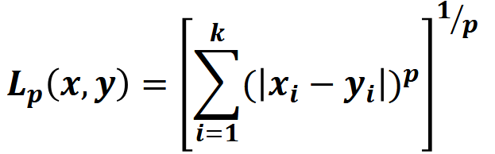
L_{p} – Norm
Also known as Minkowski norm or Minkowski distance
L₂: Euclidean
L₁: Manhattan
L∞: max
L_{- ∞} : min
(city block distance) (chess board distance)

Slide 10
Properties of a Metric Distance
Let us consider pixels
p with coordinates (x, y)
q with coordinates (s, t)
z with coordinates (u, v)
A distance function D need to satisfy following properties to be a metric distance
Non-negativity: D(p, q) ≥ 0, ∀ p, q
Identity: D(p, q) =0 if p=q, ∀ p, q
Symmetry: D(p, q) = D(q, p), ∀ p, q
Triangular inequality: D(p, z)≤ D(p, q)+D(q, z),∀ p, q, z

Slide 11
Is Minkowski distance (L_{p} norm) a Metric?
Yes, for 1 ≤ p < ∞
No, if p<1
When p<1, it does not satisfy the triangular
inequality
(0, 1)
(1,1)
₂1/p
– Example:
(0,0)
the distance between (0,0) and (1,1) is 2^{1/p} > 2, but the point (0,1) is at a distance 1 from both of these points.
Since this violates the triangle inequality for p<1,
Minkowski distance is not a metric distance for p<1

Slide 12
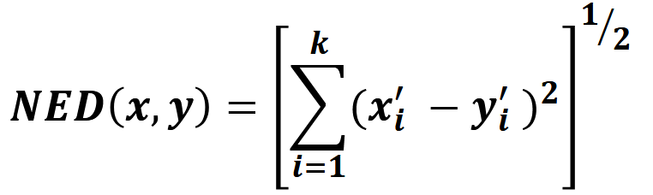
Normalized Euclidean Distance
Normalization of features can be done in various ways.
One of the popular normalization techniques is “Z-score Normalization”:
Z-score Normalization
Each feature dimension i is made mean-centered and normalized as follows
𝑥′ = (𝑥_{𝑖} − 𝜇_{𝑖} )/𝜎_{𝑖}
𝑖
𝜇_{𝑖} and 𝜎_{𝑖} are the mean & standard deviation of feature 𝑖𝑖 for all the subjects used in training.
Is it a Metric distance? Yes

Slide 13
CS419/619: Computer Vision
13

Slide 14
Distance Measures
Part - 2

Slide 15
Content
Recap of the last class
A new distance measure:
–Quadratic form distance

Slide 16
Recap
Euclidean Distance:
D_{e}(p, q) = [(x-s)² + (y-t)²]^{1/2}
 |  | 2
 | 2 | 1 | 2
2 | 1 | 0 | 1 | 2
 | 2 | 1 | 2
 |  | 2
City Block
City Block (Manhattan) Distance:
D₄(p, q) = |x-s| + |y-t|
2 | 2 | 2 | 2 | 2
2 | 1 | 1 | 1 | 2
2 | 1 | 0 | 1 | 2
2 | 1 | 1 | 1 | 2
2 | 2 | 2 | 2 | 2
Chess Board (max) Distance:
D₈(p, q) = max(|x-s|, |y-t|)
Chessboard Block

Slide 17
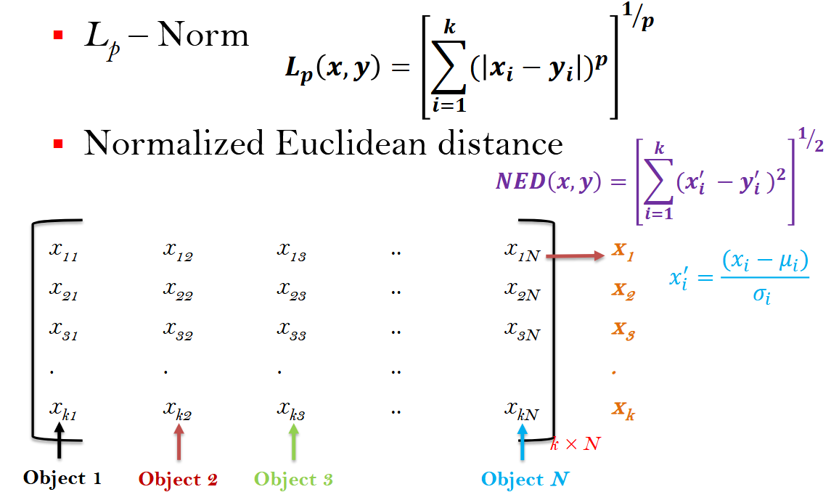
Recap

Slide 18
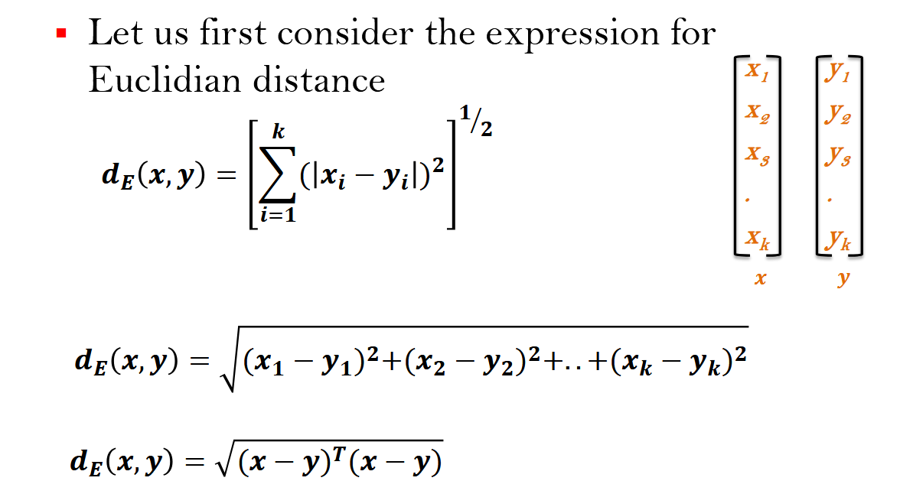
Quadratic Form Distance

Slide 19
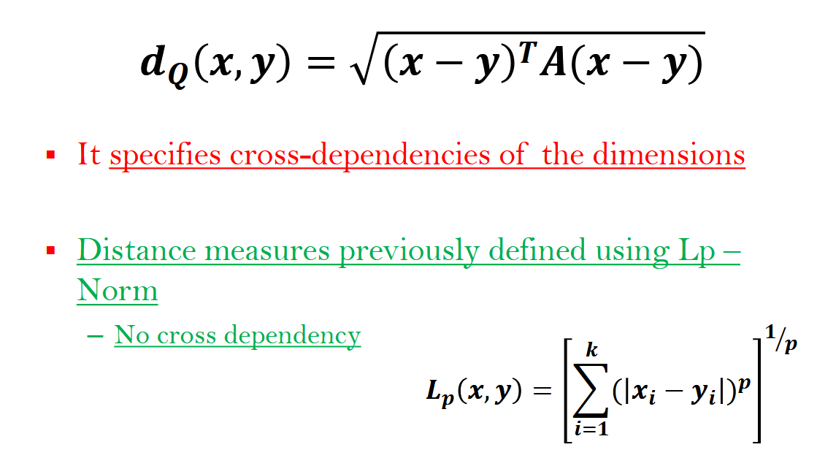
Quadratic Form Distance

Slide 20
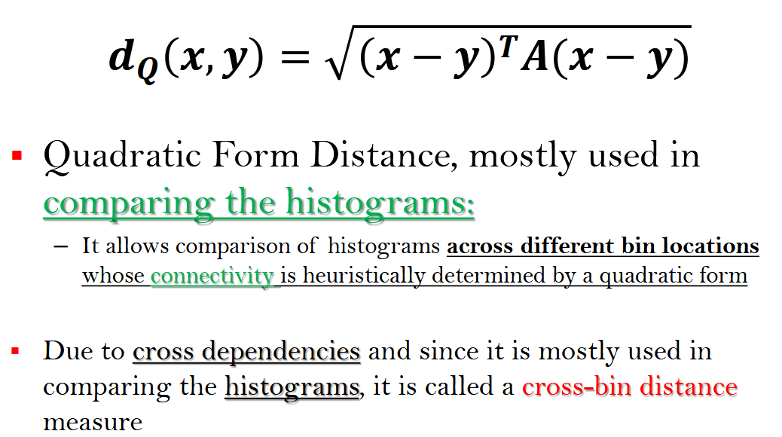
Quadratic Form Distance

Slide 21
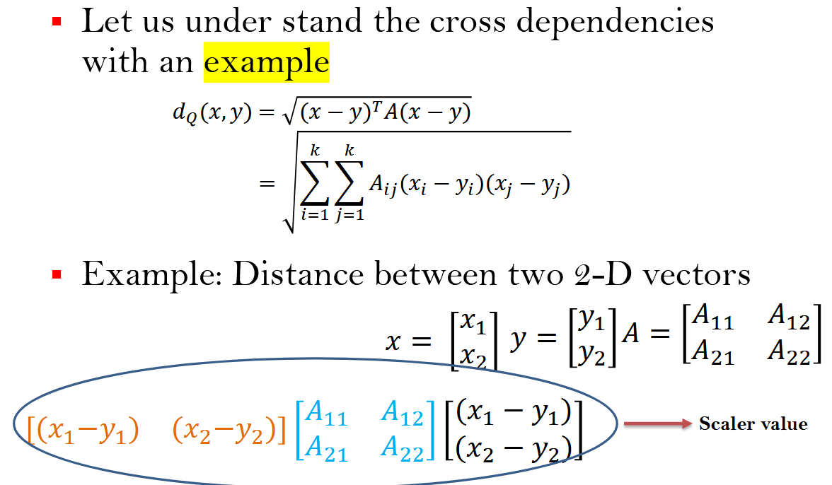
Quadratic Form Distance

Slide 22
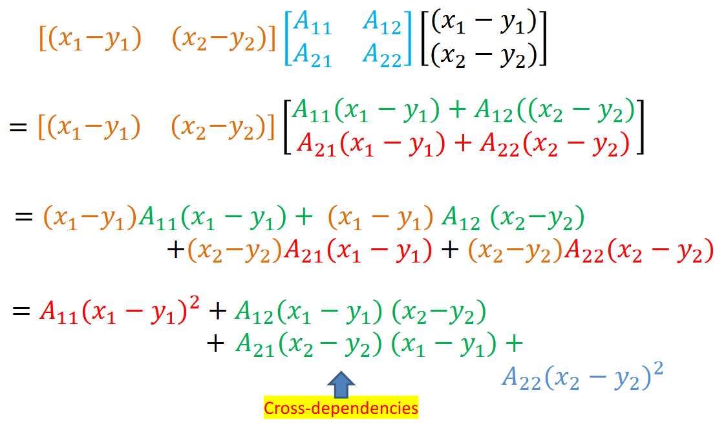
Quadratic Form Distance

Slide 23
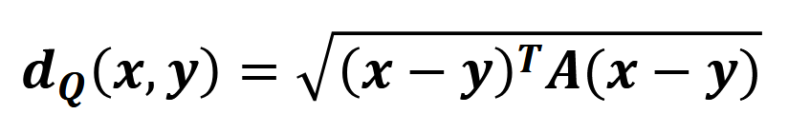
Quadratic Form Distance
A is similarity matrix of size k × k
A_{ij} denotes the similarity (or weight) of dimension i with dimension j
Note:
– A is positive semi-definite (for distances to be ≥ 0)

Slide 24
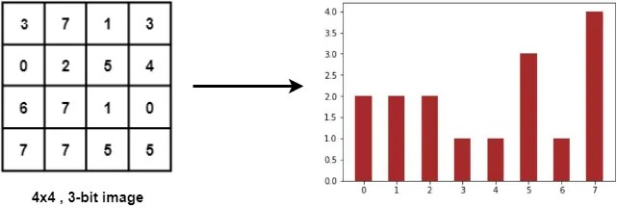

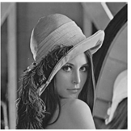
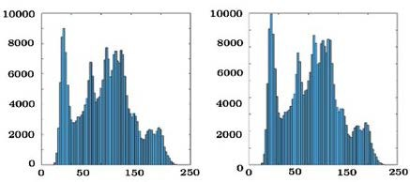
Quadratic Form Distance
Comparison of histograms

Slide 25
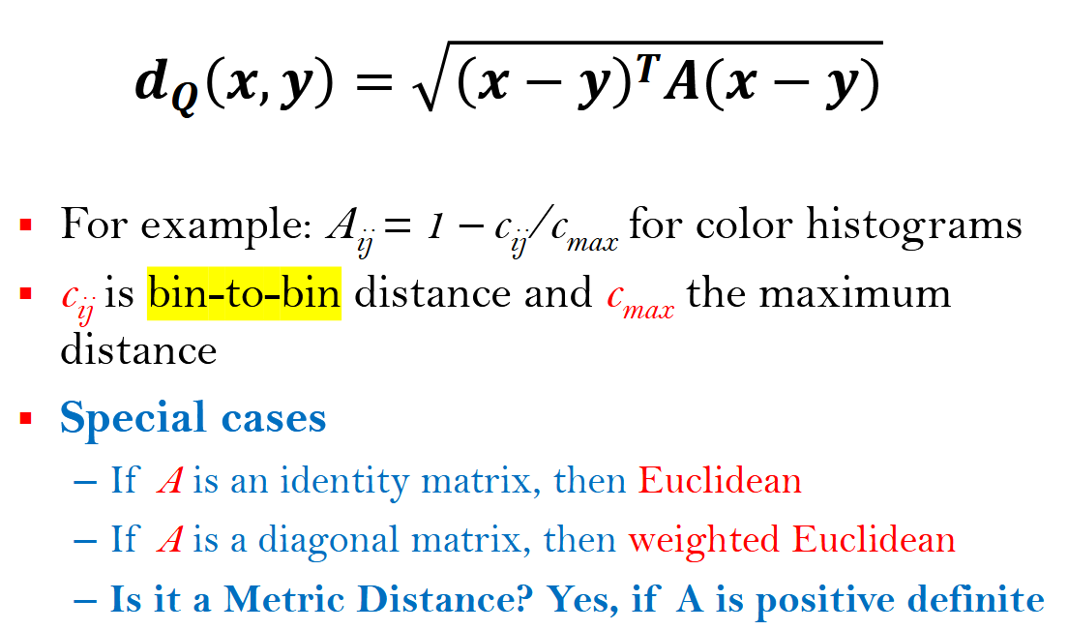
Quadratic Form Distance

Slide 26
Quadratic Form Distance-Summary
Euclidean Distance
It is totally determined for the two vectors
Weighted Euclidean distance is a little more flexible
It can control the effect of individual vector components onto the overall distance
Quadratic Form Distance
It specifies cross-dependencies of the dimensions

Slide 27
Quadratic Form Distance-Summary
QFD represents correlation between dimensions
Euclidean
weighted Euclidean
Quadratic Form
circles for iso-surfaces
iso-oriented ellipsoids
ellipsoids
(Not necessarily aligned to the coordinate axis)
Iso-oriented – the sides of the object are parallel to the axes of the coordinate system.

Slide 28
Comparison of Color Histograms
An application of Quadratic Form Distance
– Considers similarity between colors i and j
Dim. 1 2 3 d
p
Euclidean Distance
q
color histograms
p
Quadratic Form Distance (QFD)
q
color histograms

Slide 29
Comparison of Color Histograms
p
Quadratic Form Distance (QFD)
q
color histograms
Similarity weights?
–Distance between the bins
Bin distance = difference of indices

Slide 30
Comparison of Color Histograms
Let d(i,j) represents distance of bin i and j
Similarity matrix can be computed as
_{Aij = e}-σ.d(i,j)
where the parameter σ controls the global shape of the similarity matrix

Slide 32
Distance Measures
Part - 3

Slide 33
Content
Mahalanobis distance
–Extension of quadratic form distance
Histogram Intersection
–Used to compare histograms

Slide 34
Mahalanobis Distance
To understand this, let us first understand
–Mean
–Variance
–Expectation of a variable
–Covariance Matrix

Slide 35
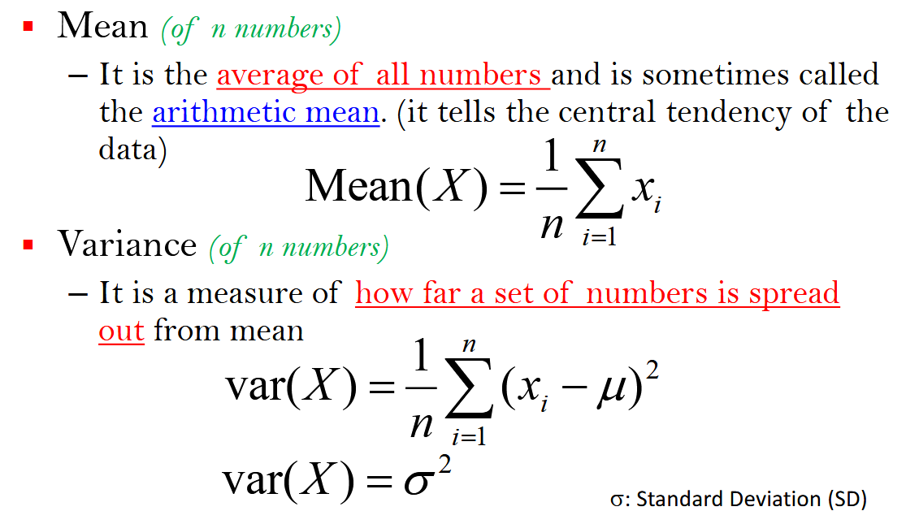
Mean & Variance

Slide 36
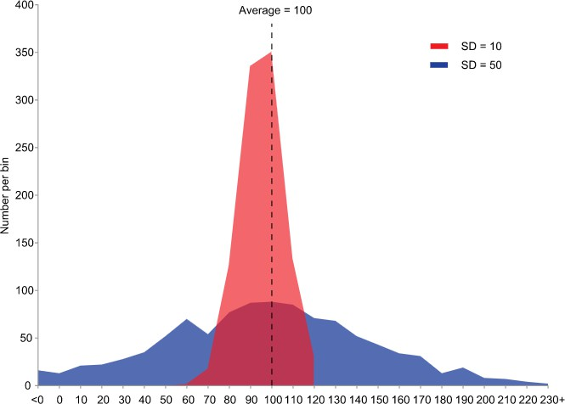
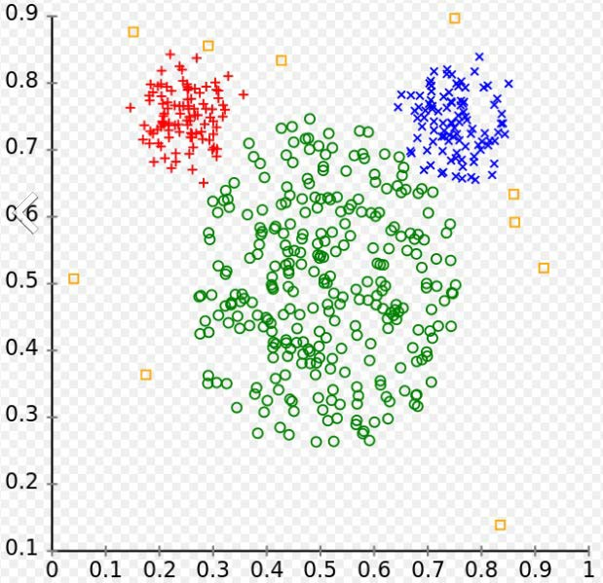
Mean-variance Examples
Example of samples from two populations with the same mean but different variances. The red population has mean 100 and variance 100 (SD=10) while the blue population has mean 100 and variance 2500 (SD=50).
Data with different mean and variance Green samples have more variance as compared to red and blue points

Slide 37
Mean & Variance using Expected Value
Mean and variance –
When variable is a random variable
Definition given in terms of expected value
Mean
Expected value of random variable X
Variance:
The variance of a random variable X is the expected value of the squared deviation from the mean

Slide 38
Mean & Variance using Expected Value
Expectation (Expected Value)
– In probability and statistics, Expected value refers to the value of a random variable one would expect to find if one could repeat the random variable process an infinite number of times and take the average of the values obtained
More formally, the expected value is a weighted average of all possible values
In probability and statistics, usually mean and expected value are used synonymously
A good discussion on Expectation can be found at https://www.probabilitycourse.com/chapter3/3_2_2_expectation.php

Slide 39
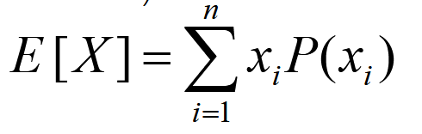
Mean & Variance using Expected Value
Expectation:
Suppose random variable X can take value x₁ with probability p₁, value x₂ with probability p₂, and so on, up to value x_{k} with probability p_{k}.
Then the expectation of this random variable X
(expected value of X) is defined as
– where x_{i} represents a possible value of random variable X and P(x_{i}) its probability

Slide 40
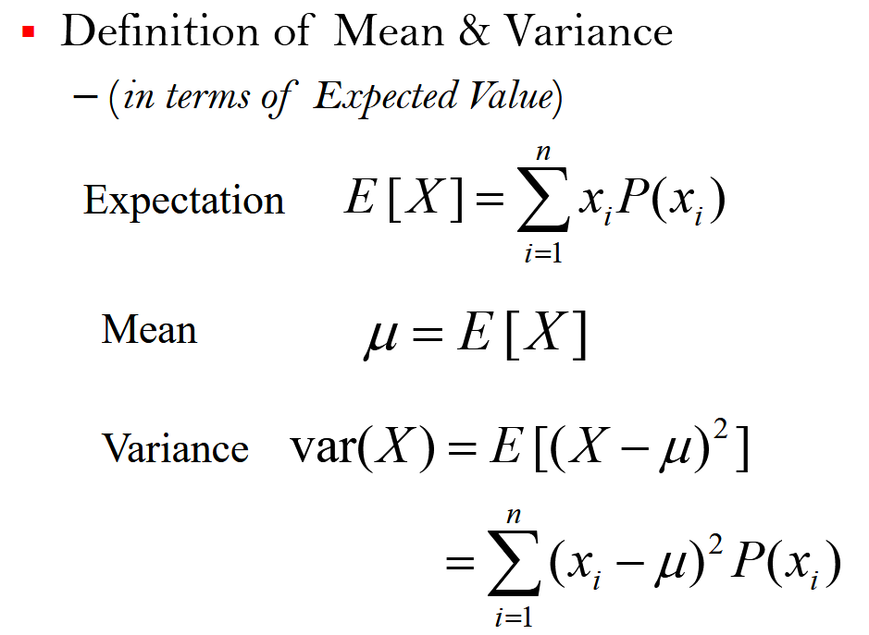
Mean & Variance using Expected Value
CS419/619: Computer Vision
9

Slide 41
Example
Let us consider a discrete random variable X with range R_{X}={x₁,x₂,x₃,...}.
This random variable is a result of random experiment.
Suppose that we repeat this experiment a very large number of times N, and that the trials are independent.
Let
# times x₁ is observed: N₁,
# times x₂ is observed: N₂
# times x_{k} is observed: N_{k}
and so on.
10

Slide 42
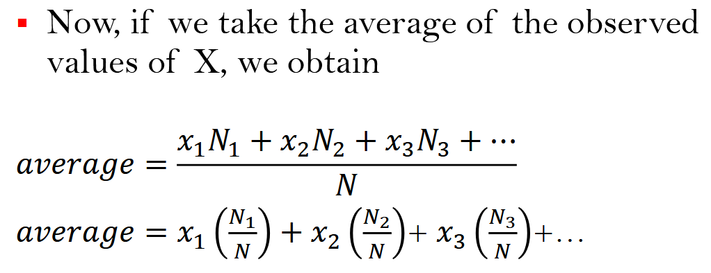
Example ….contd

Slide 43
Covariance
Covariance:
It is a measure of how much two random variables change together
Here, we are seeking to determine the correspondence between the deviation scores on two variables with respect to mean
We see the extent to which those deviation scores vary together (i.e., covary)

Slide 44
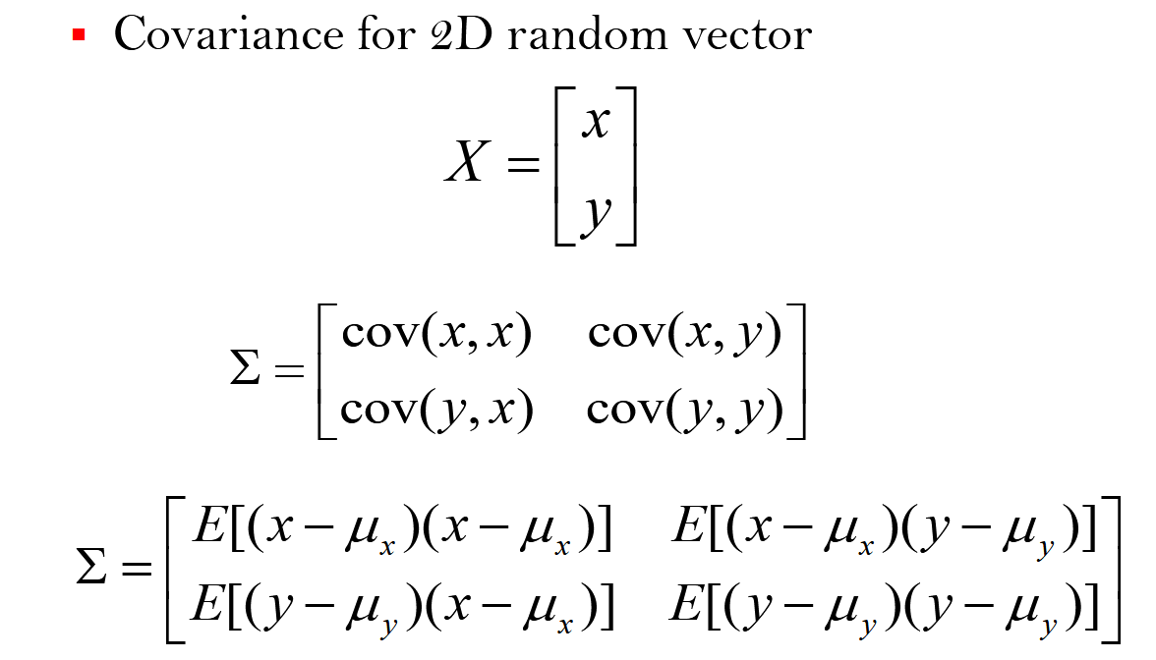
Covariance Matrix

Slide 45
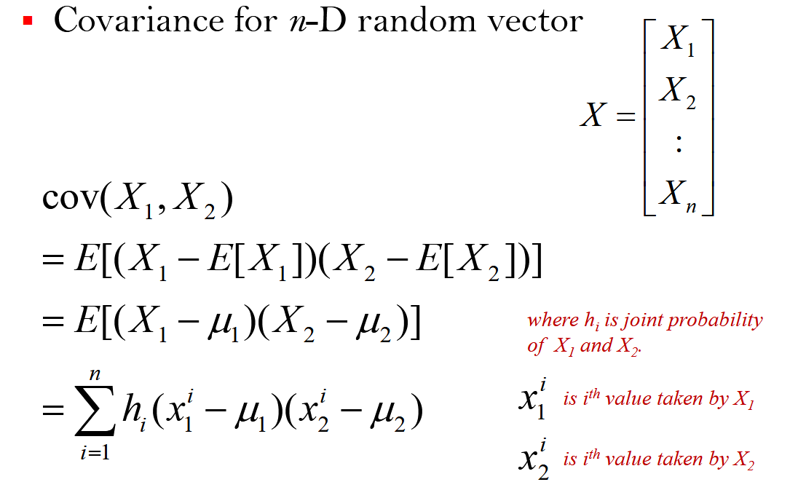
Covariance

Slide 46
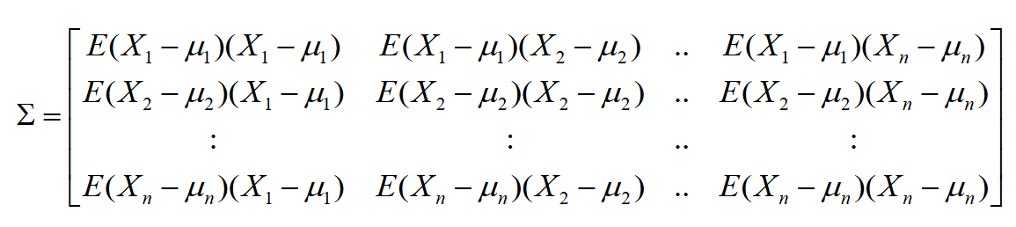
Covariance Matrix
Covariance Matrix
– It is a matrix whose element in the i, j position is the covariance between the i ^{th} and j ^{th} elements of a random vector X (a vector of random variables)

Slide 47
Covariance
Positive Covariance:
If greater values of one variable correspond with the greater values of the other variable (and vice-versa) , i.e. when variables tend to show similar behavior, the covariance is positive
Negative Covariance
When greater values of one variable correspond to the smaller values of the other, i.e., when the variables tend to show opposite behavior, the covariance is negative
Zero Covariance (uncorrelated data):
When this average product is zero, we say the two variables do not co-vary together. Sample which are high on one variable are just as likely to be high on the other as they are to be low on the other
Random variables whose covariance is zero are called uncorrelated
Sign of Covariance: The sign of the covariance shows the tendency in the linear relationship between the variables

Slide 48
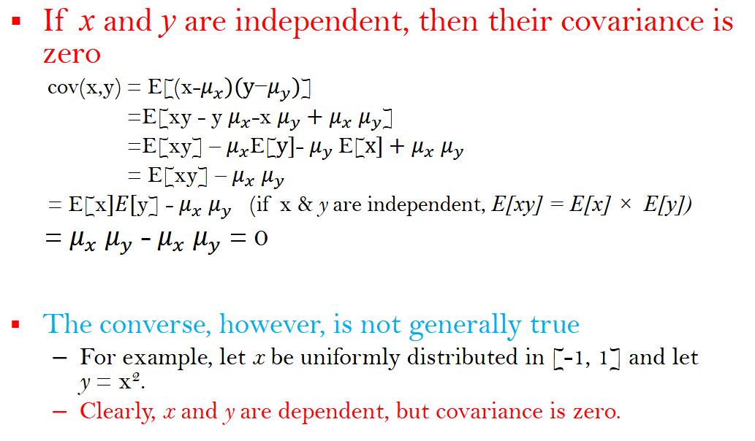
Covariance

Slide 49
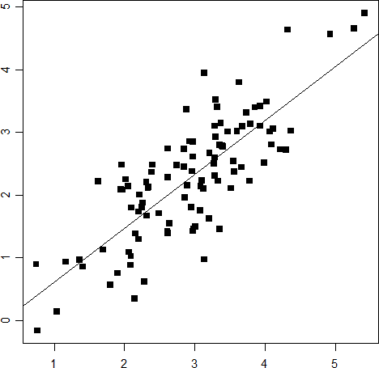
Example – Positive Covariance
These two variables positively covary
People who drink a lot of coffee tend to be happy, and people who do not tend to be unhappy
Preview:
The line is called a regression line, and represents the estimated linear relationship between the two variables.
Note that the slope of the line is positive in this example
y
x

Slide 50
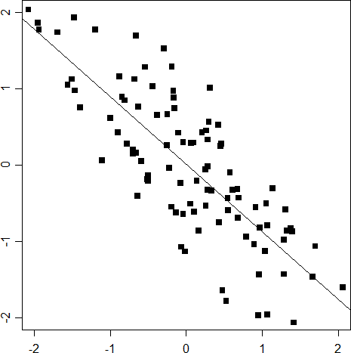
Example – Negative Covariance
In this example, the two variables covary negatively
Value high on x tend to be low on y
The regression line has a negative slope
y
x

Slide 51
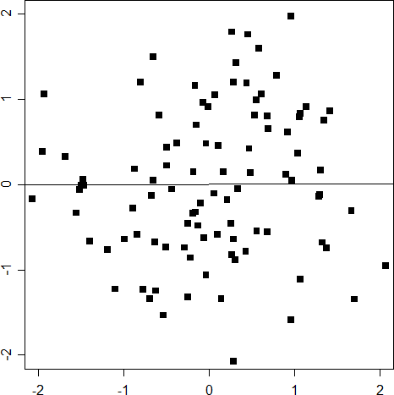
Example – No Covariance
In this example, there is no covariance between the two variables
Samples who are high on x are just as likely to be high on y as they are low on y
The regression line is flat
y
x

Slide 52
Properties of Covariance Matrix
Diagonal Covariance Matrix
It means all your variables are uncorrelated, i.e., the entries of the random vector are uncorrelated
Inverse of Covariance Matrix
Also known as concentration matrix or the precision matrix
The elements of the precision matrix have an interpretation in terms of partial correlations and partial variances
Covariance matrix can represent relation between all variables while inverse covariance shows the relation of elements with their neighbors

Slide 53
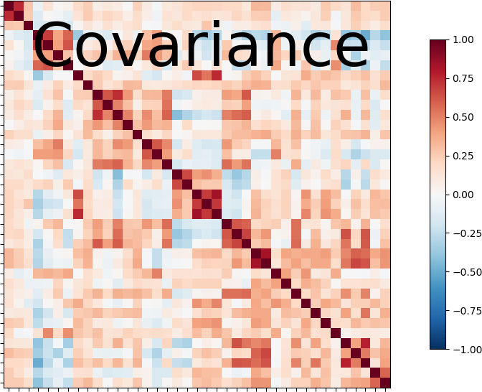
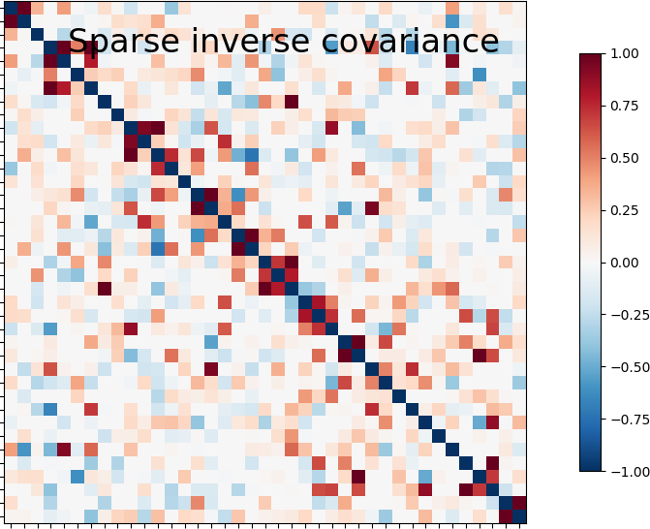
Properties of Covariance Matrix
Image source: https://nilearn.github.io/auto_examples/03_connectivity/plot_inverse_covariance_connectome.html

Slide 54
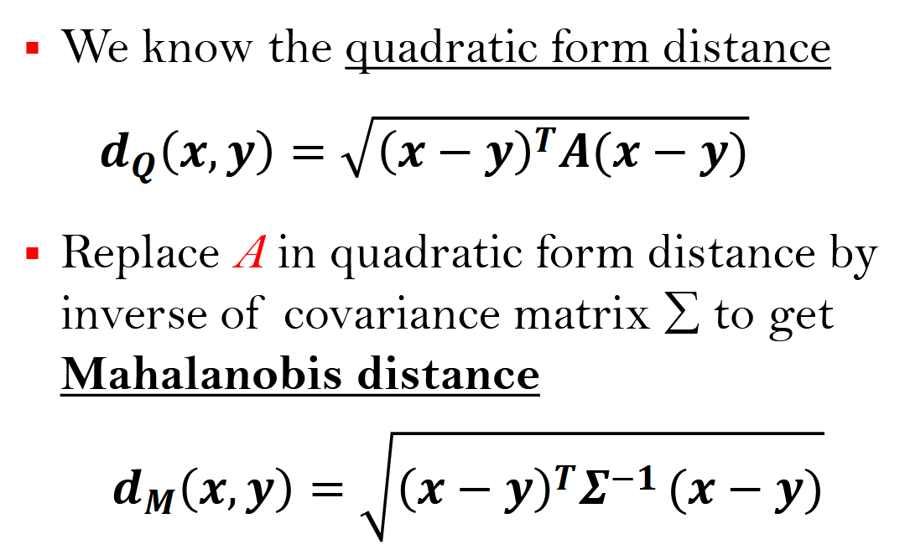
Mahalanobis Distance

Slide 55
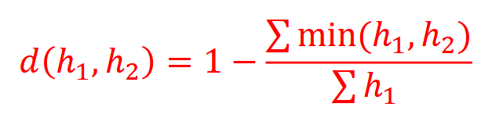
Histogram Intersection
Used to compare two histograms
– Histograms originating from various applications, not necessarily from images only
Defined as follows (for two histograms ℎ₁, ℎ₂):
Is it a metric distance?
No
It is non-symmetric
So not a metric distance

Slide 56
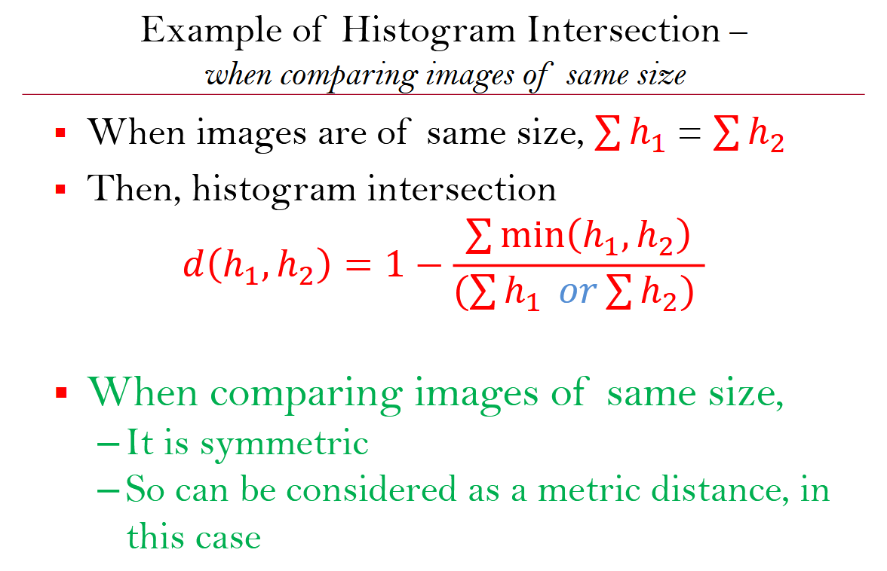

Slide 57



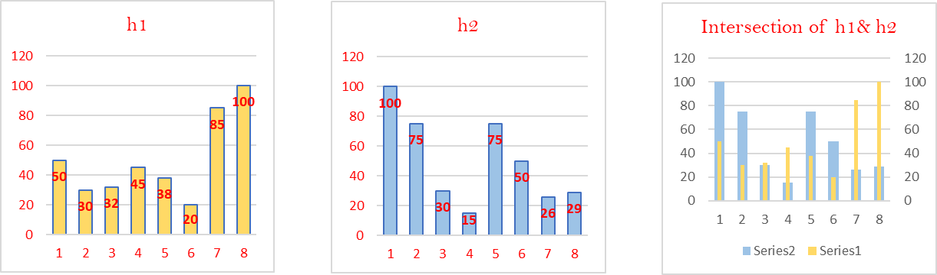
Example – comparison of same size images
Image -1
20 x 20
Image -2
20 x 20
 | Bin-1 | Bin-2 | Bin-3 | Bin-4 | Bin-5 | Bin-6 | Bin-7 | Bin-8 | Total Pixels
h1 | 50 | 30 | 32 | 45 | 38 | 20 | 85 | 100 | 400 | d(h1,h2) | 0.405
h2 | 100 | 75 | 30 | 15 | 75 | 50 | 26 | 29 | 400 | d(h2,h1) | 0.405
min(hi,h2) | 50 | 30 | 30 | 15 | 38 | 20 | 26 | 29

Slide 58
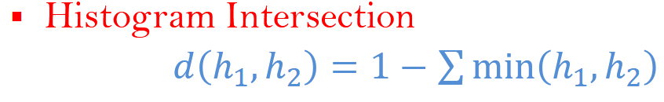
Histogram Intersection –when histograms are normalized
When histograms are normalized
each bin value of h₁ or h₂ is divided by total number of image pixels in respective images
In such case, ∑ ℎ₁ = ∑ ℎ₂ =1
When comparing normalized histograms,
It is symmetric
So can be considered as a metric distance, in this case

Slide 59
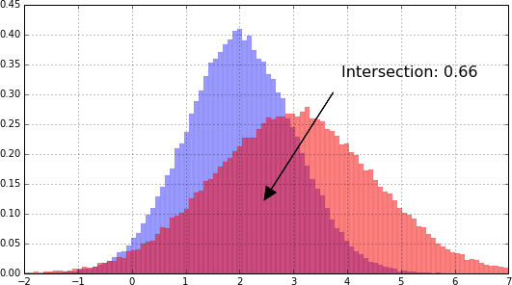
Example - when histograms are normalized
Images can be of same size or different sizes
Image source: http://blog.datadive.net/histogram-intersection-for-change-detection/

Slide 60
Various Ways of Matching Histogram
Euclidian Distance
Easy to compute
Histogram Intersection
Easy and faster to compute
Chi-squared distance
Often works better
Quadratic form Distance
Good when nearby bins represent similar values
Earth Mover’s Distance
Good when nearby bins represent similar values
Bhattacharya Distance
Compare normalized histograms

Slide 61

Application of Histogram Intersection
Estimation of Image Similarity
Content Based Image Retrieval
– Based on image similarity
Test image
Database image-1
Database image-2
Change detection
Database image-3
– Change detection in two distributions
Image source: https://www.pyimagesearch.com/2014/07/14/3-ways-compare-histograms-using-opencv-python/

Slide 63
Distance Measures
Part - 4

Slide 64
Content
Cosine Distance
Bhattacharyya Distance

Slide 65

Cosine Distance
Image – 2 (50 x 50)
Image – 1 (200 x 200)
Image-1 is 4 times of Image-2,
Say there are 8 different gray levels in these images
– H₂ = [a, b, c, d, e, f, g, h], H₁ = [4a, 4b, 4c, 4d, 4e, 4f, 4g, 4h]
Based on histograms comparison
– Can we say that these two images are same?

Slide 66

Cosine Distance
Image – 2 (100 x 100)
Image – 1 (200 x 200)
Based on histograms comparison
– Are these two images same?
– Euclidean distance – No
Manhattan distance (Citi block distance) – No
Cosine distance – Yes

Slide 67
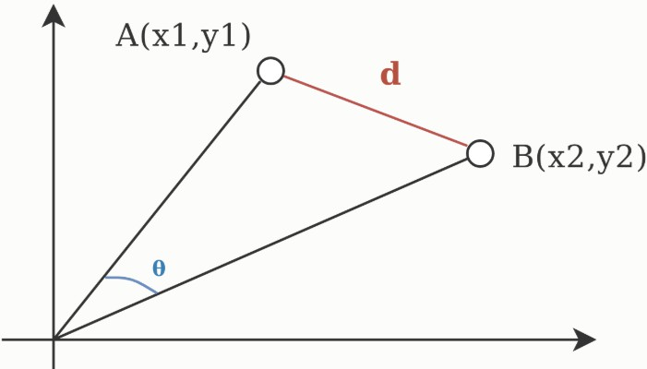
Cosine Distance
Cosine distance between two vectors is the angle subtended by them at the origin
d: Euclidian distance d_{θ}: Cosine distance
𝑑_{𝜃} = 1 − cos θ

Slide 68
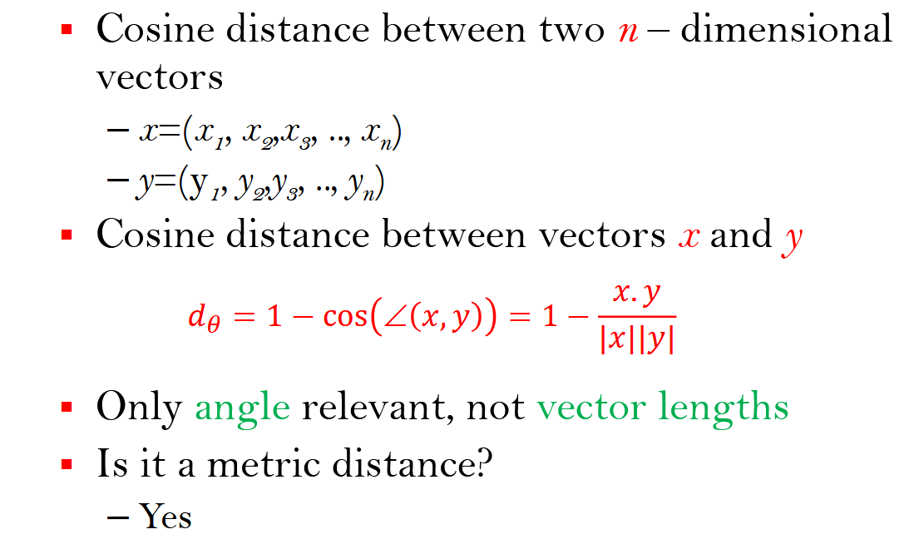
Cosine Distance

Slide 69
Cosine Distance
In cosine distance
Angle 0 degree (cosine distance = 0)
for identical vectors
Angle 90 degrees (cosine distance = 1)
for dissimilar vectors
Application:
Used when magnitude of the vector does not have much significance

Slide 70
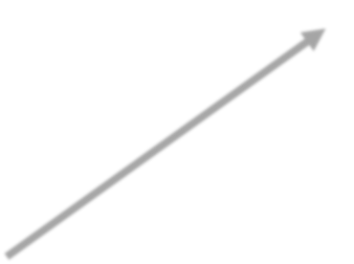


Image Matching Example
Image – 2 (100 x 100)
Image – 1 (200 x 200)
8-dimensional space
H₁
H₂ = [a, b, c, d, e, f, g, h],
H₁ = [4a, 4b, 4c, 4d, 4e, 4f, 4g, 4h]
H₂
Cosine distance = 0

Slide 71
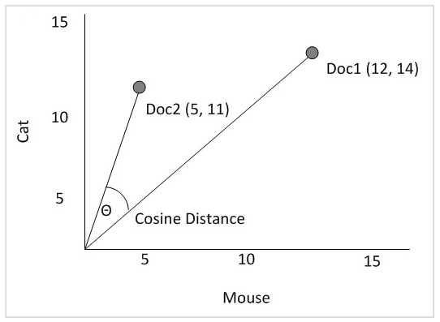
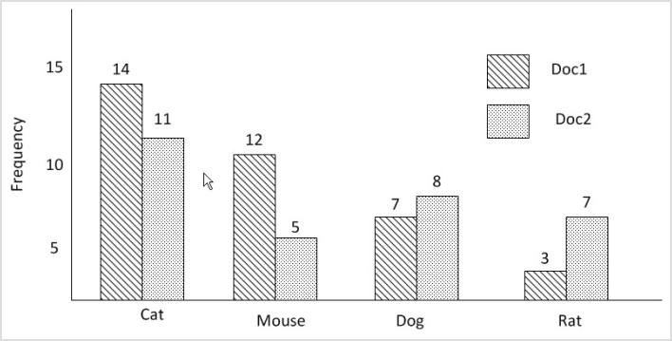
Cosine Distance - Applications
Documents matching
Two documents may be considered same if they have certain important words with same frequency
However, a document with, say, twice as many occurrences of all words compared to another document will be regarded as identical.
Image source: https://nickgrattan.wordpress.com/2014/06/10/euclidean-manhattan-and-cosine-distance-measures-in-c/

Slide 72
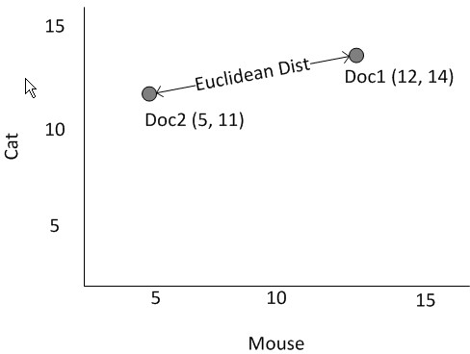
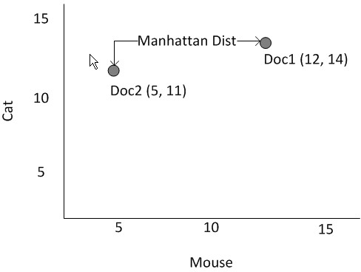
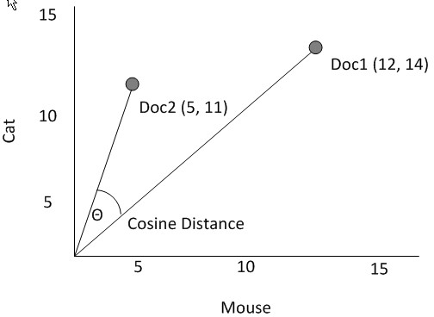
Comparison of three Distances

Slide 73
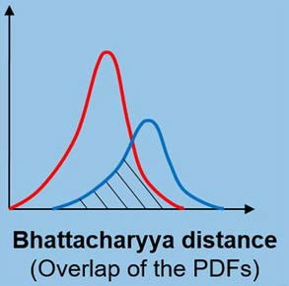
Bhattacharyya Distance
It is based on Bhattacharyya coefficient
Bhattacharyya coefficient
– It is an approximate measurement of the amount of overlap between two statistical samples/distribution
– The coefficient can be used to determine the relative closeness of the two samples being considered.
Image source: https://doi.org/10.1016/j.ymssp.2019.04.035

Slide 74
Bhattacharyya Distance
Bhattacharyya Distance
It is based on Bhattacharyya coefficient
In statistics, the Bhattacharyya distance measures the similarity of two discrete or continuous probability distributions.
Bhattacharyya Coefficient and Distance
Both measures are named after Anil Kumar Bhattacharya, (ISI Kolkata, 1930)

Slide 75
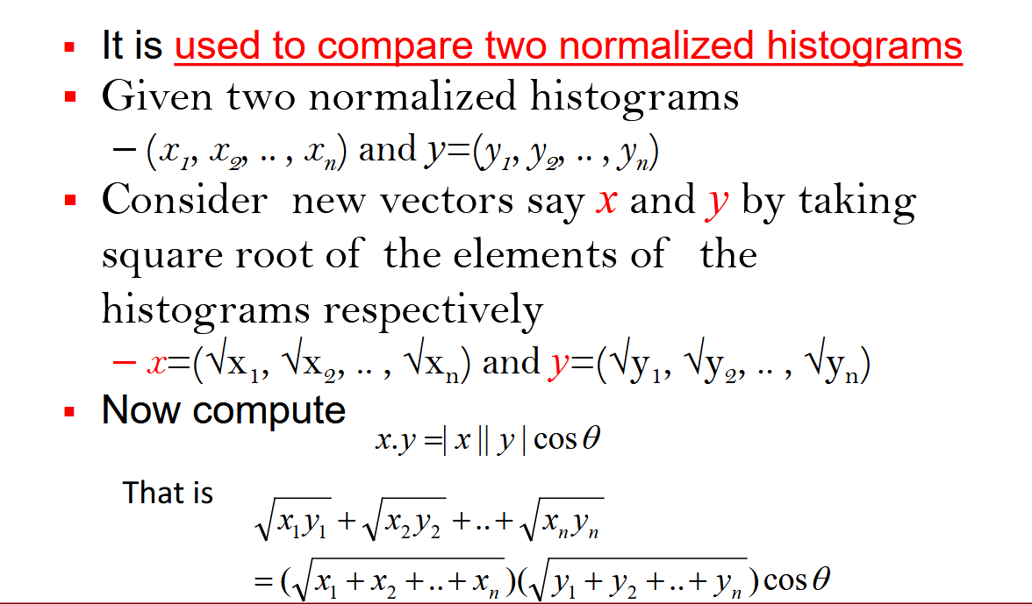
Defining Bhattacharyya Coefficient

Slide 76
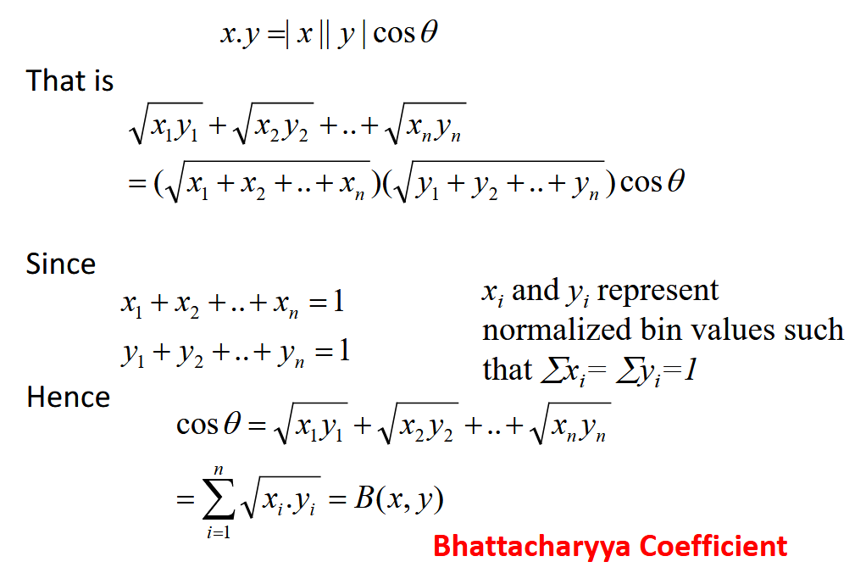
Bhattacharyya Distance

Slide 77
Bhattacharyya Distance
Bhattacharya Coefficient:
Measures cosine angle between (√x₁, √x₂, .. , √x_{n}) and
y=(√y₁, √y₂, .. , √y_{n})
Hellinger Distance
d_{H} = 1 – B(x,y)
Metric? Yes
Bhattacharya Distance
d_{B} = - ln B(x,y)
Metric? No

Slide 78
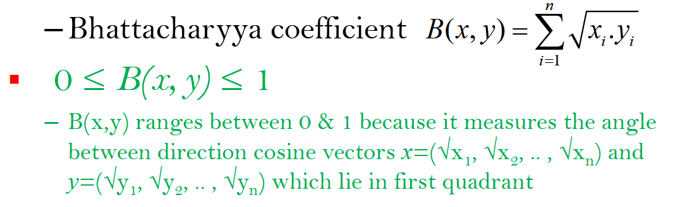
Bhattacharyya Distance
Is Bhattacharyya Distance a metric distance?
– No
Explanation:

Slide 79
Bhattacharyya Distance
d_{B} = - ln B(x,y)
0 ≤ B(x, y) ≤ 1
Since
Hence 0 ≤ d_{B} < ∞
It is clear from the above equation that Bhattacharyya Distance does not follow the triangle inequality
Hence Bhattacharyya Distance is not a metric distance

